Slide 1
MODIFICATION OF TRACTOR SEAT SUSPENSION SYSTEM FOR BETTER COMFORT OF THE OPERATOR

Slide 2
MODIFICATION OF TRACTOR SEAT SUSPENSION SYSTEM FOR BETTER COMFORT OF THE OPERATORS
TEAM MEMBERS
AMALJITH C R KNR16ME011
AMAL M KNR16ME012
ANUVIND CHANDRAN KNR16ME019
ARAVIND R KNR16ME020
HARIKRISHNAN A KNR16ME033
GUIDE
Dr. SUDHEESH KUMAR C P
ASSOCIATE PROFFESSOR MED GCE KANNUR

Slide 3
INTRODUCTION
India had been a farming nation for ages.
Even now one third of rural population of India live on farming.
As technology progressed number of changes took place such as mechanization of farming with shift from bulls to the use of tractor.
Since India has the largest area of arable land there is no wonder that Mahindra is the largest tractor manufacturer in the world.
As the government of India emphasize return to farming and improvement of working conditions of farmers tractor industry will play a key role in the economy.

Slide 4
INTRODUCTION
There are usually two kinds of vibration transmitted to operator.
1 - Whole body vibration 2 - Hand arm vibration.
Whole body vibration
Range 1-60 Hz
Transmitted when human body in a seated posture above a vibrating body.
This kind of vibration is commonly experienced by the tractor operators since they are sitting on tractor for a prolonged time, usually duration of 2-3 hrs.
Exposure to such vibration for a long term will cause reproductive issue , loss of eye sight etc. Along with these issues back pain is also experienced by tractor operators.

Slide 5
INTRODUCTION
Reducing vibration, which is transmitted to operator through seat, can bring huge change in their body fitness.
Even a small reduction in vibration can bring a notable impact on their lives.
Hand arm vibration, on the other side, is of range 1-500 Hz. This is usually transmitted through steering wheel, clutch, brake and accelerator. It also depends on road conditions. So reduction of HAV is out of scope of this project

Slide 6
Literature Review

Slide 7
LITERATURE REVIEW
1) Mayton et al.
Conducted study among quarry workers on WBV and HAV.
Found that HAV not an issue.
2) Shankar and Alphonso et al.
Studied the concept of a lateral seat suspension as a means of improving the ride comfort in off-road vehicles.
A computer parametric study
3) Stikeleather and Stuggs et al.
They developed system to improve sitting comfort.
One of the major drawback is that it is not economical.

Slide 8
LITERATURE REVIEW
4) Kim et al.
Conducted vibration studies mainly among on reducing the vibration
The results showed that the active vertical seat suspension signiﬁcantly reduced the vertical (z-axis) vibration
5) Langer et al.
His work shows that educating the workers can reduce health hazards upto 22.5%
6) Ciloglu et al.
Study performed to investigate and assess the whole body vibration (WBV) and the dynamic seat comfort of aircraft seats under three different flight conditions. Take off , landing and cruise
Business class seat cushion significantly reduced the whole body vibration exposure
7) Azizan et al.
Measured drowsiness before and after 30 minutes exposure to vibration

Slide 9
LITERATURE REVIEW
All the previous studies related to tractor seat suspension system were simulation analysis
One of the latest paper of such type was by Pradhan et al.(2019)
They made a simulation model in AMESim software

Slide 10
OBJECTIVES
To analyze vibration levels to transmitted to the operator seat through the seat suspension system.
To conduct a field study of the effect of vibrations on the operator.
To propose a design modification to the current passive suspension system

Slide 11
Simulation Results

Slide 12
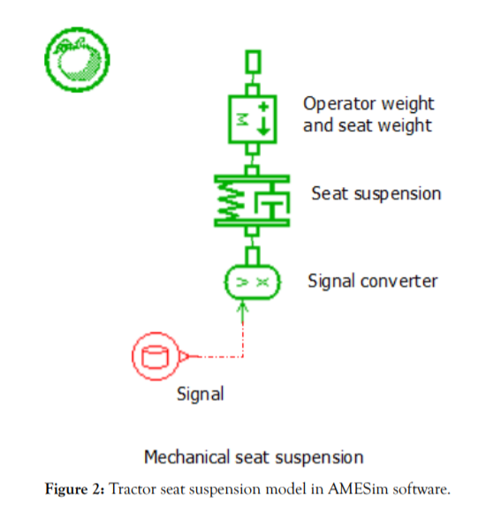
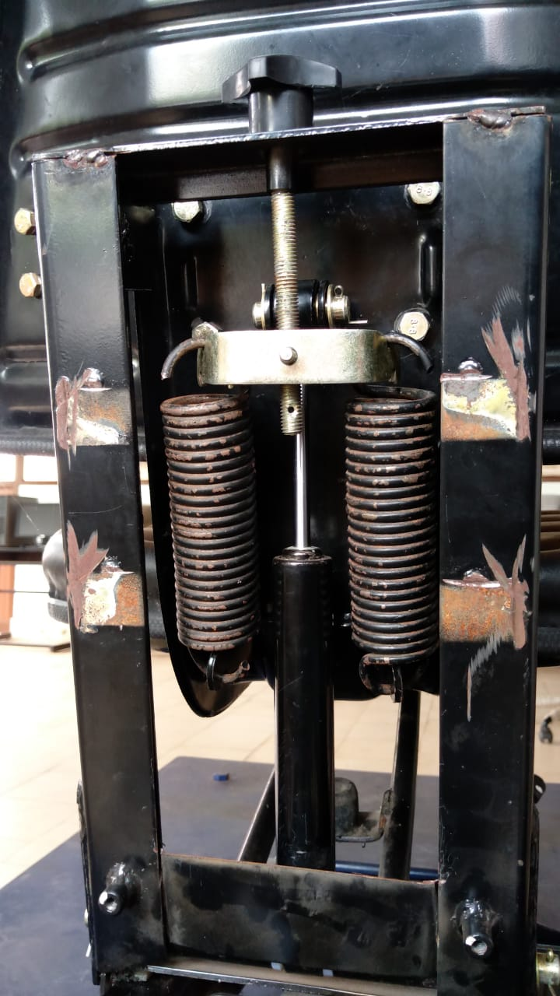
Simulation Model Actual model

Slide 13
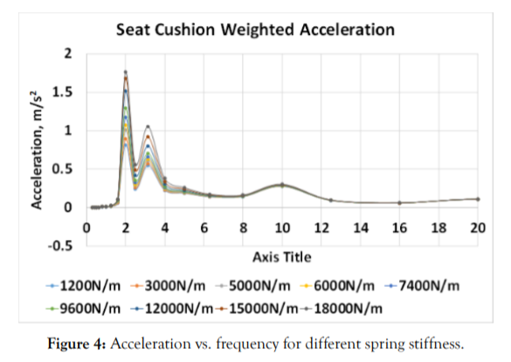
Results
SIMULATION RESULTS
Amplitude of vibration for different values of spring constant(Effective spring constant)

Slide 14
Inference
SIMULATION RESULTS
From this study it can be inferred that
The obtained result shows that the amplitude of vibrations vary as spring stiffness changes at a particular damping constant
The nature of variation is that the amplitude increases with increase in stiffness of the springs

Slide 15
FIELD STUDY
A field study conducted to find out amplitude of vibration from Engine in running condition and idle condition
7 peak values of amplitude of vibration were collected
For taking each sample tractor made to run along 1 Km road
Tractor Arjun 555, Mahindra
Operator mass measured using portable weighing machine and found out to be 50 kg

Slide 16

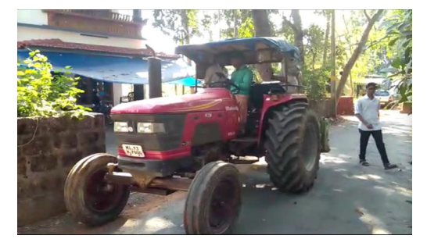
FIELD STUDY
Paddy field was unavailable then so experimental trial were conducted on straight road

Slide 17
FIELD STUDY
A set of questions were asked to the operator
His experience is also same as that we obtained in literature review
Back pain is a serious problem, apart from back pain the operator could also experience loss of concentration, nausea etc
These kind of problems were mainly faced during ploughing season in while working for 2-4 hrs continuously
The operator also concluded that vibration from clutch ,brake, steering and accelerator are negligible as compared to vibrations from seat and suggested placing a foam cushion will also improve ride comfort

Slide 18
FIELD STUDY
Following are the data obtained from field study
Trial number | Peak Z_{rms} (m/s²⁾
1 | 2.323
2 | 1.730
3 | 2.335
4 | 1.991
5 | 3.260
6 | 0.369
7 | 1.307

Slide 19
INTRUMENTS USED
Human Vibration meter
Seat pad tri axial accelerometer
Vibration meter
Electrodynamic shaker
Power oscillator
Vibrating platform
PC with vibration analysis software

Slide 20
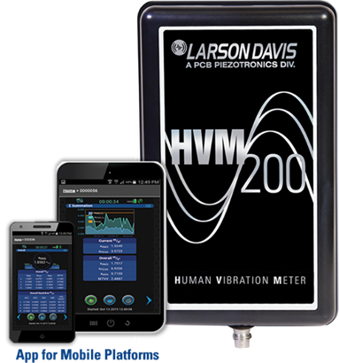
Human Vibration Meter
The HVM200 is a small rugged vibration meter with built in Wi-Fi that can be used to measure hand-arm, whole body and general vibration.

Slide 21
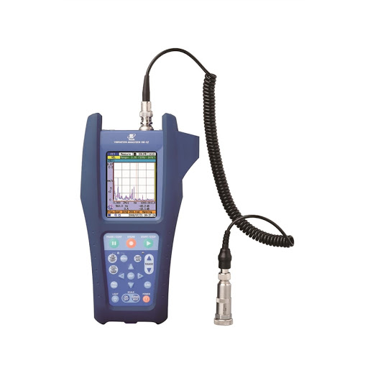
Vibration Analyser
Vibration analyser VA-12 (RION) is an equipment for diagnosis and on-site measurements. It is a vibration meter with FFT analysis function that allows simultaneous measurement of acceleration, velocity, displacement.

Slide 22
Vibration analysis software
The vibration analysis software used is LD G4 Utility software which enables to connect, control, download, and view data from multiple devices simultaneously as well as view data graphically and in spread sheet format, generate reports, and easily export in Excel® format for further data analysis.

Slide 23
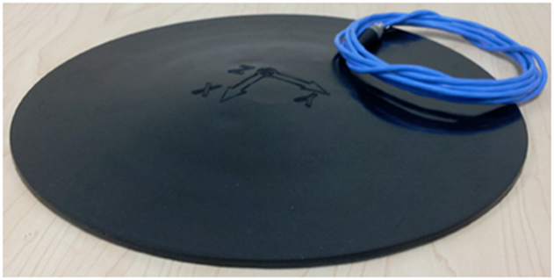
Tri - axial accelerometer
Provide simultaneous measurements in three orthogonal directions, for analysis of all of the vibrations being experienced by a structure.

Slide 24
EXPERIMENTAL SETUP
The experimental setup consists of a vibrating platform supported by four springs. The tractor seat is mounted on the top of the platform.
Shaker is placed beneath the platform. The input to the shaker is given via the power oscillator
Seat pad tri axial accelerometer is placed on the tractor seat.
Seat pad is connected to HVM 200 which is connected to the PC containing the analysis software.
The vibration meter RION’s VA-12 is placed on the vibrating platform.

Slide 25
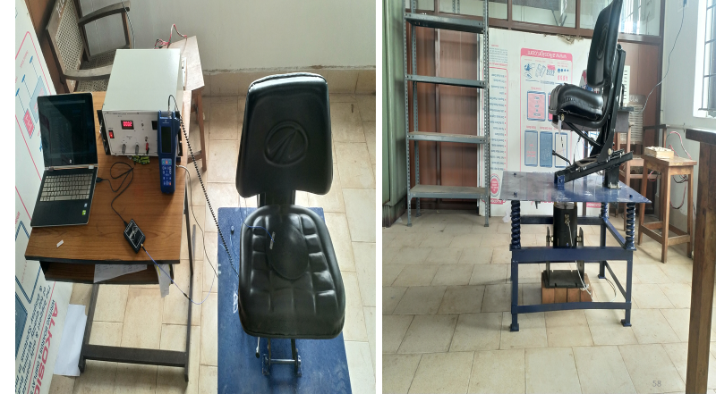
EXPERIMENTAL SETUP

Slide 26
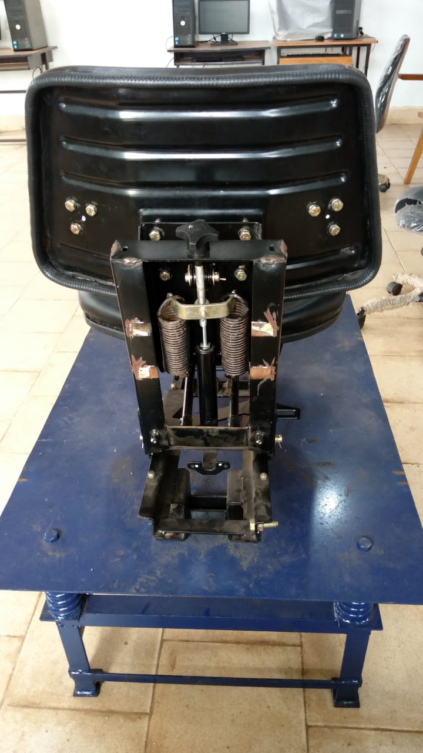
EXPERIMENTAL SETUP
Dismantled portion
Suspension Springs

Slide 27
EXPERIMENTAL PROCEDURE

Slide 28
EXPERIMENTAL PROCEDURE
Instruments are mounted as shown in setup figure
Electrodynamic shaker vibrates the platform when power supply is given transmitting the vibrations through the seat suspension to the seat
Frequency is varied over 5 Hz to 33 Hz
Amplitude data is collected to system using LD G4 utility software through the tri – axial accelerometer
Experiments are carried for specimen of 50 kg, 60 kg, 67 kg, 80 kg
The results are tabulated and plotted

Slide 29
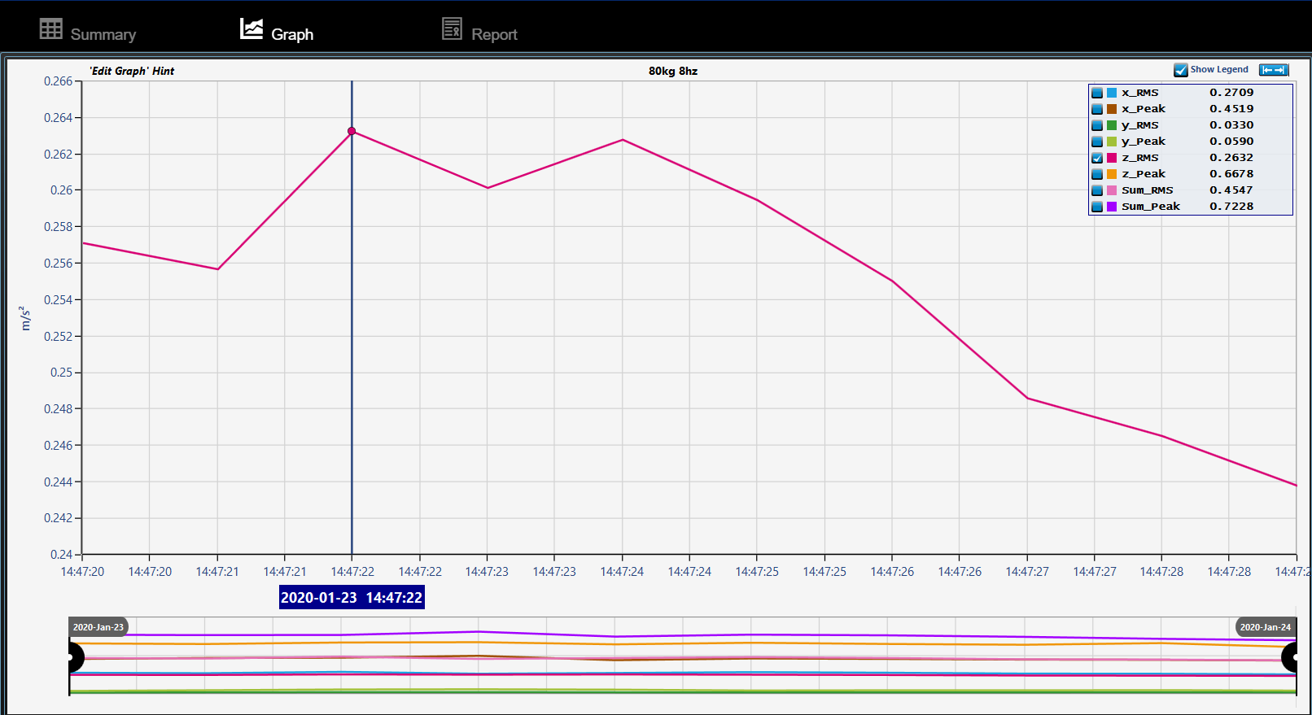
EXPERIMENTAL PROCEDURE

Slide 30
RESULTS AND PLOTS
EXPERIMENTAL PROCEDURE
1) For 50 kg
Frequency ( Hz) | Xrms ( m/s²) m/s² | Yrms( m/s²) | Zrms( m/s²)
5 | 0.1094 | 0.0128 | 0.1244
8 | 0.262 | 0.0416 | 0.2613
11 | 0.1695 | 0.0444 | 0.806
15 | 0.3523 | 0.0498 | 1.2821
17 | 0.3919 | 0.0169 | 1.5498
20 | 0.2854 | 0.0424 | 1.0194
23 | 0.3213 | 0.0513 | 0.7706
25 | 0.2588 | 0.0331 | 0.7134
28 | 0.238 | 0.0128 | 0.794
30 | 0.2302 | 0.0998 | 0.48
33 | 0.3245 | 0.0908 | 0.3383

Slide 31
EXPERIMENTAL PROCEDURE
2) 60 kg
Frequency (Hz) | Xrms (m/s²) m/s² | Yrms ( m/s²) | Zrms ( m/s²)
5 | 0.0998 | 0.012 | 0.0946
8 | 0.4411 | 0.0861 | 0.2313
11 | 0.3271 | 0.1112 | 0.713
15 | 0.6743 | 0.021 | 1.2731
17 | 0.2609 | 0.0413 | 1.165
20 | 0.2843 | 0.0396 | 1.1427
23 | 0.2 | 0.0281 | 0.8367
25 | 0.192 | 0.0301 | 0.7435
28 | 0.0766 | 0.0123 | 0.6603
30 | 0.091 | 0.0388 | 0.5864
33 | 0.1227 | 0.069 | 0.4963

Slide 32
EXPERIMENTAL PROCEDURE
3) For 67 kg
Frequency ( Hz) | Xrms ( m/s²) m/s² | Yrms( m/s²) | Zrms( m/s²)
5 | 0.1056 | 0.0321 | 0.0983
8 | 0.2298 | 0.052 | 0.201
11 | 0.3942 | 0.0318 | 0.5514
15 | 0.5614 | 0.0365 | 0.8765
17 | 0.2154 | 0.0376 | 1.1349
20 | 0.3333 | 0.051 | 1.2891
23 | 0.1981 | 0.0282 | 0.906
25 | 0.1481 | 0.0353 | 0.7094
28 | 0.0962 | 0.0403 | 0.6507
30 | 0.1372 | 0.065 | 0.6858
33 | 0.1144 | 0.0913 | 0.4573

Slide 33
4) 80 kg
EXPERIMENTAL PROCEDURE
Frequency ( Hz) | Xrms ( m/s²) m/s² | Yrms( m/s²) | Zrms( m/s²)
0 | 0 | 0 | 0
5 | 0.2225 | 0.0655 | 0.1505
8 | 0.2955 | 0.0344 | 0.2632
11 | 0.261 | 0.0473 | 0.7566
15 | 0.3404 | 0.0121 | 1.2304
17 | 0.2455 | 0.315 | 1.4328
20 | 0.1438 | 0.03 | 1.577
23 | 0.1185 | 0.0363 | 1.2766
25 | 0.1042 | 0.0266 | 1.0942
28 | 0.1372 | 0.028 | 0.8444
30 | 0.0894 | 0.0212 | 0.6679
33 | 0.1222 | 0.0275 | 0.5241

Slide 34
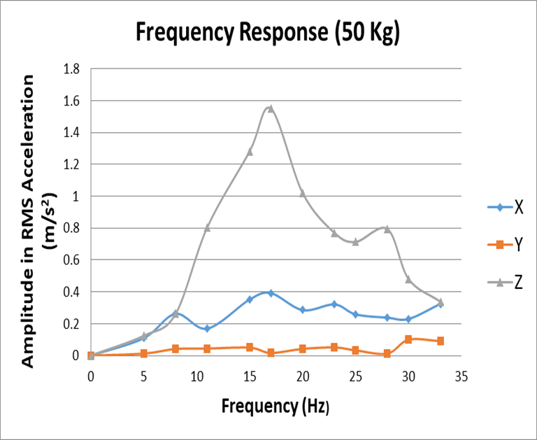
EXPERIMENTAL PROCEDURE

Slide 35
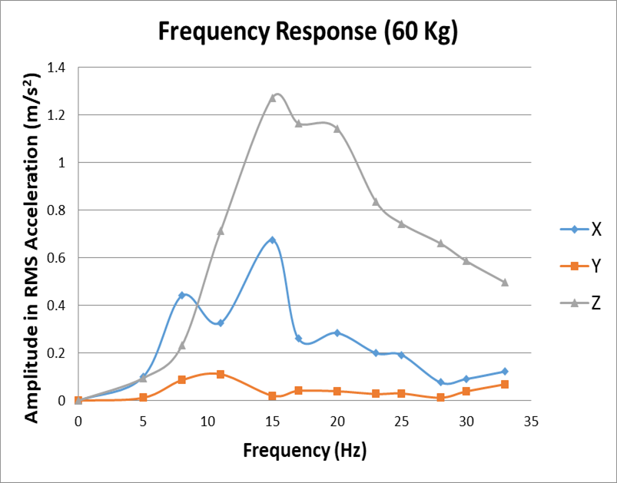
EXPERIMENTAL PROCEDURE

Slide 36
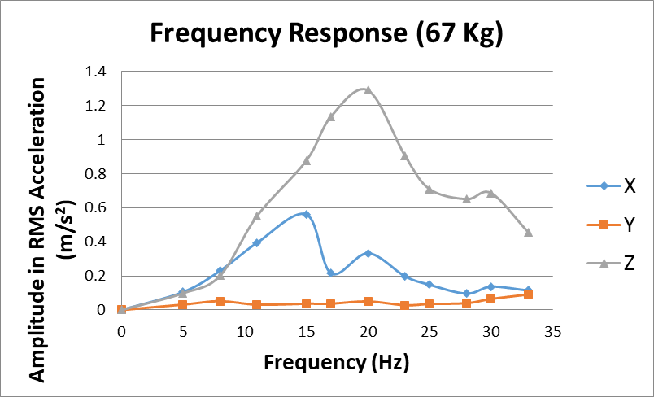
EXPERIMENTAL PROCEDURE

Slide 37
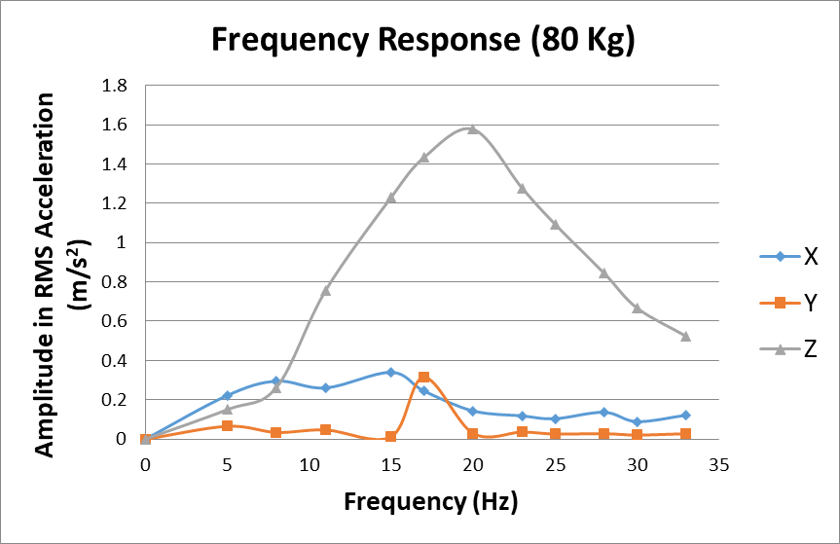
EXPERIMENTAL PROCEDURE

Slide 38
EXPERIMENTAL PROCEDURE
Z_{rms} is the dominant factor
Resonant frequency is obtained at 17 Hz, 15 Hz, 20 Hz. 20 Hz for masses 50 kg, 60kg, 67kg, 80kg respectively.
Hence resonant frequency ranges from 15 to 20 Hz
X_{rms} is almost half the dominant factor, Y_{rms} remains low. This can vary since it realtes to pitching and rolling motion.

Slide 39
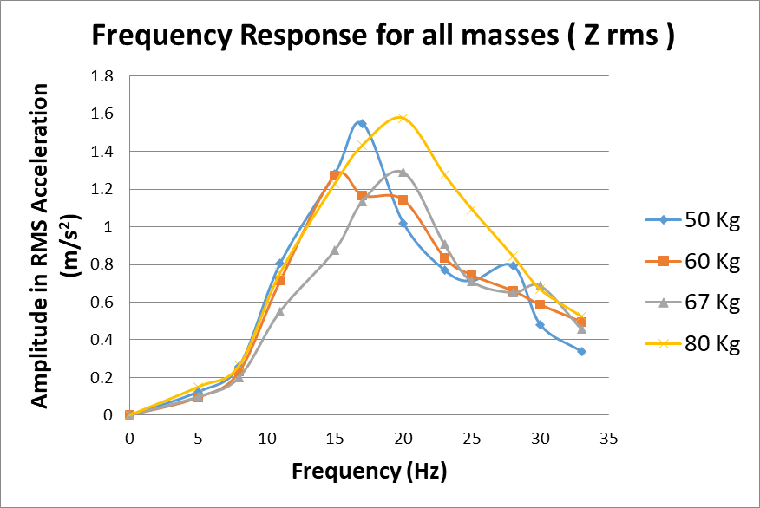
EXPERIMENTAL PROCEDURE
Executes Engine vibrations
In Field study peak amplitudes will be at lower fequencies due to pitching and rolling motions combined

Slide 40
EXPERIMENTAL PROCEDURE
From the above chart it can be seen that peak amplitude of vibrations for each mass varied between 1.3 m/s2 to 1.6 m/s2
From field study its observed that amplitude of vibration changes from 0.369 to 3.260 m/s2
But most of the time it vary between 1.3- 2.3 m/s2
This shows that experimental set up is sufficient to carry out further analysis

Slide 41
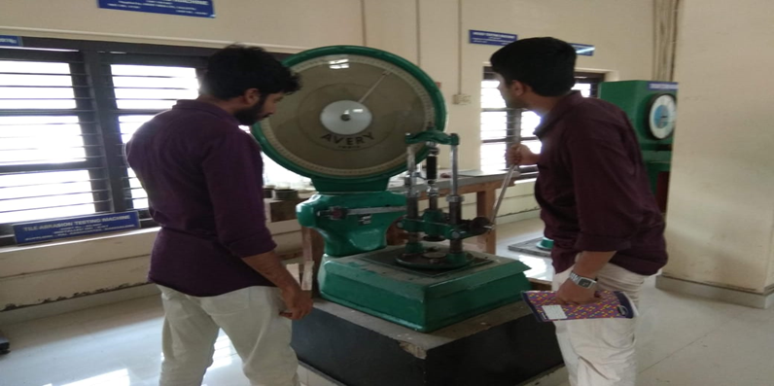
Determining Spring Stiffness
EXPERIMENTAL PROCEDURE
The spring constant or spring stiffness value is found by
Load – Deflection test

Slide 42
EXPERIMENTAL PROCEDURE
The results are tabulated as follows:
Graphical Method
Applied Force ( kgf) | Deflection (mm) |  | Mean (mm) X
 | Loading | Unloading
4 | 1 | 1 | 1.0
8 | 3 | 2 | 2.5
12 | 7 | 9 | 8.0
16 | 17 | 15 | 16.0
20 | 24 | 23 | 23.5
24 | 32 | 31 | 31.5
28 | 39 | 37 | 38.0
32 | 45 | 45 | 45.0
36 | 53 | 52 | 52.5
40 | 60 | 60 | 60.0

Slide 43
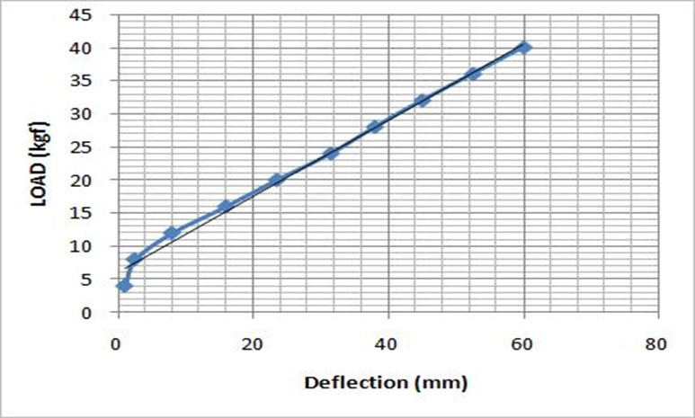
EXPERIMENTAL PROCEDURE
Slope of the above graph is the spring constant
= 5400 N/m

Slide 44
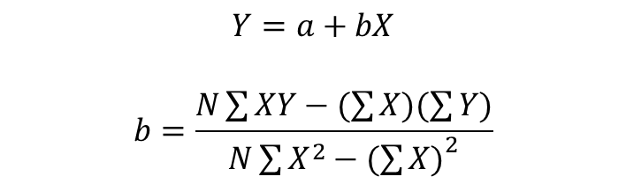
EXPERIMENTAL PROCEDURE
Regression Line Method
Applied Force ( kgf) Y | Deflection (mm) |  | Mean X (mm) | X² | XY
 | Loading | Unloading
4 | 1 | 1 | 1 | 1 | 4
8 | 3 | 2 | 2.5 | 6.25 | 20
12 | 7 | 9 | 8 | 64 | 96
16 | 17 | 15 | 16 | 256 | 256
20 | 24 | 23 | 23.5 | 552.25 | 470
24 | 32 | 31 | 31.5 | 992.25 | 756
28 | 39 | 37 | 38 | 1444 | 1064
32 | 45 | 45 | 45 | 2025 | 1440
36 | 53 | 52 | 52.5 | 2756.25 | 1890
40 | 60 | 60 | 60 | 3600 | 2400
$$Y=a+bX$$
$$b=\frac{N\sum{XY}−(\sum{X)(\sum{Y)}}}{N\sum{X^{2}}−{(\sum{X)}}^{2}}$$
b – slope (Stiffness)
N – No. of observations
Stiffness = 5500 N/m

Slide 45
EXPERIMENTAL PROCEDURE
The currently used spring has stiffness value 5500 N/m
With this information in trail, new set of springs are manufactured
DESIGN SPECIFICATION

Slide 46
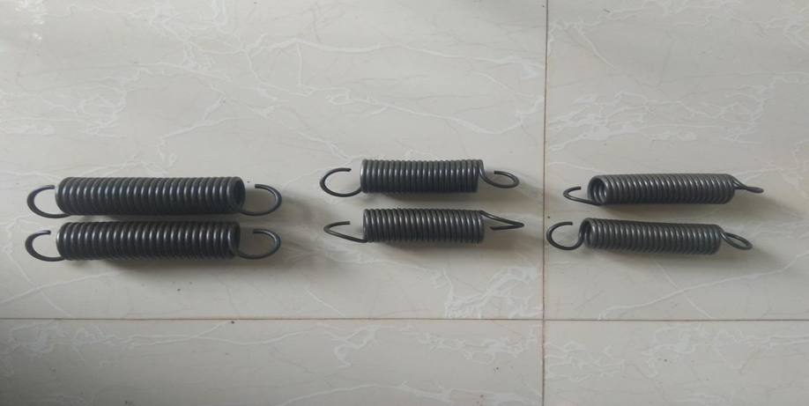
Manufactured Spring
6000 N/m
4500 N/m
5000 N/m

Slide 47
How to make suspension even more better?

Slide 48
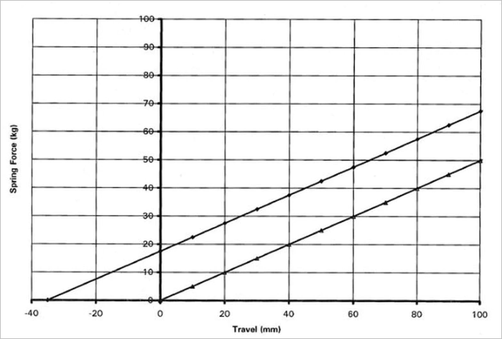
Why Preloading NB: GRAPH ONLY MEANT FOR EXPLANATION PURPOSE

Slide 49
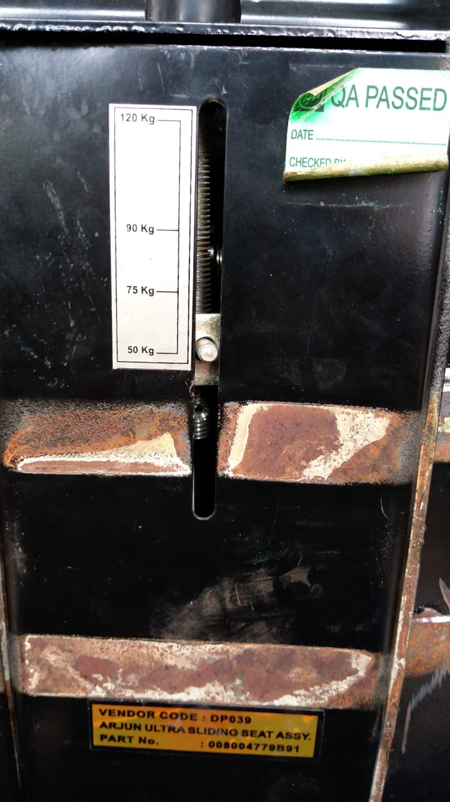
Preload (Deflection) Scale provided by manufacturer

Slide 50
Procedure
We got critical frequency range 15-20 Hz for subjects
There is a manufacturer prescribed preloading position for each mass available at the back side of the seat
At first knob is placed at marking for 50 kg;
Then harmonic force at frequency range 15-20 Hz are applied
For each frequency maximum value of amplitude is noted

Slide 51
Then knob is adjusted (one rotation )upward
Then harmonic force at frequency range 15-20 Hz are applied
For each frequency maximum value of amplitude is again noted
After 4 rotations knob brought back to prescribed position
Then it is adjusted downwards
Same procedure is repeated
A graph is plotted between knob position and amplitude is plotted

Slide 52
Preload position-Amplitude for 50 kg

Slide 53
Preload position-Amplitude for 80 kg

Slide 54
Inferences
There is an optimum preload condition for each mass at which present suspension system will give reduced amplitude of vibration
For 80 kg of obtained graph was quite different.
Its because manufacturer didn’t mention exact point of preload in their scale (After 75 kg Next is 90 kg)

Slide 55
PROPOSED DESIGN

Slide 56
As per the simulation study conducted it is observed that spring having stiffness value 4500 N/m shows least vibration characteristics.
SPRING 4500
MATERIAL GRADE 1 PATENTED AND COLD =DRAWN STEEL
MODULUS OF RIGIDITY 81000 N/mm²
WIRE DIAMETER 5 mm
INNER DIAMETER 36 mm
OUTER DIAMETER 46 mm
ACTIVE NO:OF TURNS 21
MODE OF ATTACHMENT HOOKED AT BOTHENDS
STIFFNESS 4500 N/m

Slide 57
SUMMARY AND CONCLUSIONS
Project aims at reducing vibrations levels transmitted to the operator seat of a tractor
Modification is performed on a passive seat suspension system of Mahindra Tractor seat
A field study was carried out and experiments were done in lab structure
The resonant frequency range is found to be 15 to 20 Hz

Slide 58
FUTURE SCOPE

Slide 59
A combination of new damper and spring can be incorporated to reduce vibration further
Stiffness of structure can also reduce to obtain better vibration characteristics
Hardened sponge can be replaced any other suitable material provided that it can withstand against water dust and mud for a long period of time

Slide 60
THANK YOU

